Slide 1
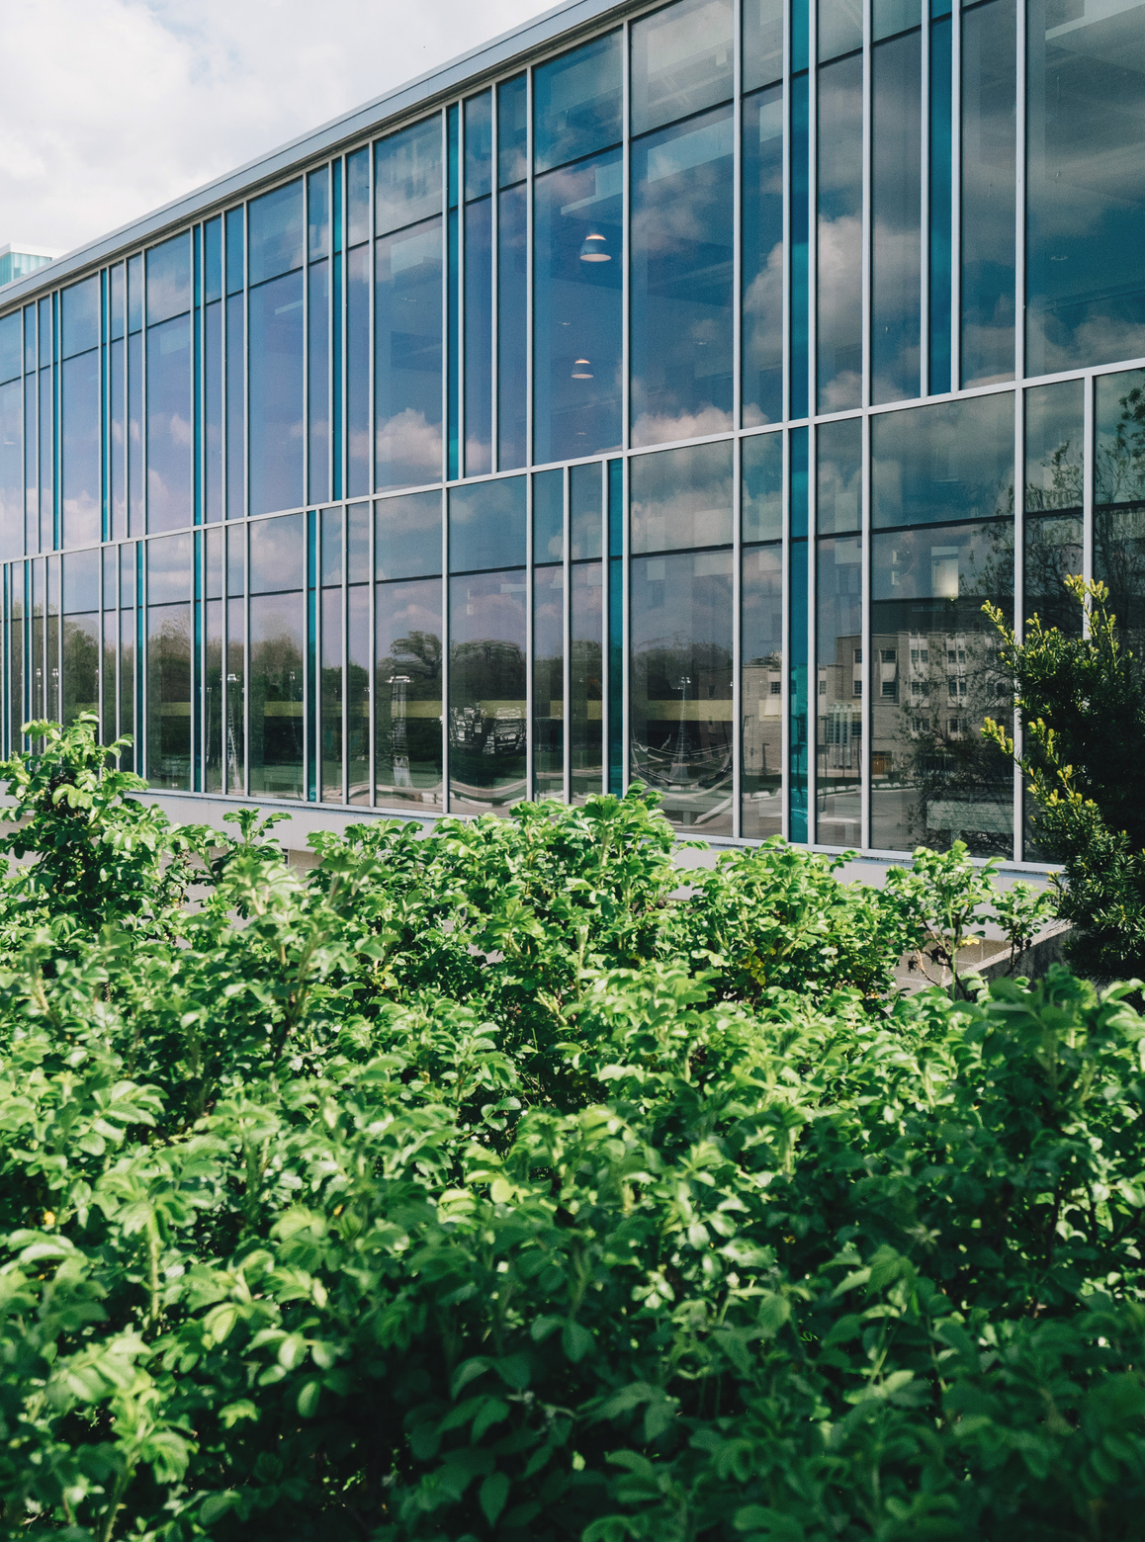
Plant Disease Detection:
Image Processing using CNNs
CSET211: Statistical Machine Learning (Odd Semester 2024-25)
Presented By
Shubham Tandon(E23CSEU1730)
Vipin Yadav (E23CSEU1728)
Abhay Pratap Singh(E23CSEU1720)

Slide 2
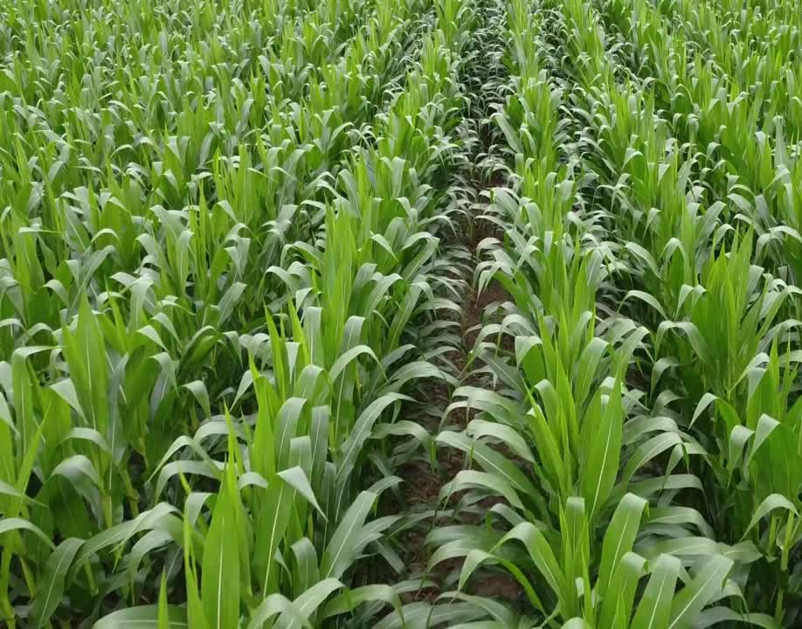
Global Challenge: The need to increase food production by 70% by 2050 to feed a growing population.
Current Issue: Plant diseases cause significant crop yield losses (up to 40% on average).
Solution: Automating disease detection through machine learning using images of plant leaves.
Project Overview:
Developed a Convolutional Neural Network (CNN)-based model to classify diseased and healthy crop leaves.
Utilized over 160,000+ labeled leaf images across 38 classes from the PlantVillage Dataset for training and validation.
Problem
Statement

Slide 3

Data Overview
PlantVillage Dataset: Dataset of diseased plant leaf images and corresponding labels
160,000+
38
Photos for training and testing of the model
Classes
Consisting of diseases and healthy leaves for various plants and crops
Split across 3 formats- Color, GrayScale, Segmented

Slide 4


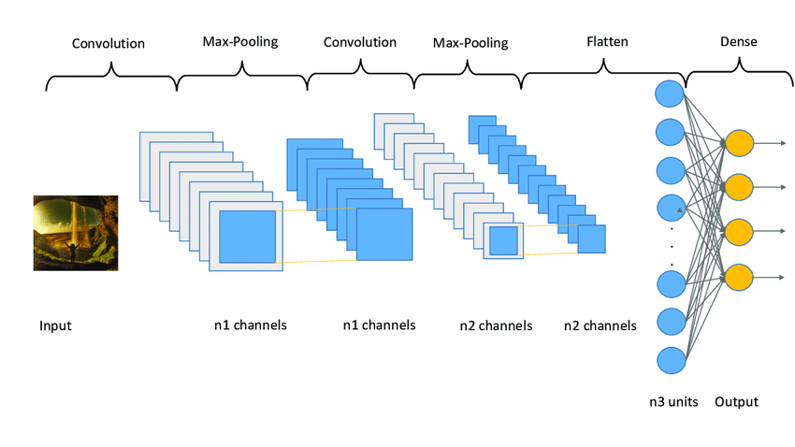
Proposed Solutions
Approach #1 – Custom CNN
Architecture: A 3-layer CNN built using TensorFlow and Keras.
Tech used: TensorFlow with Keras
Components:
Convolutional layers for feature extraction.
Max-pooling layers for dimensionality reduction.
Dense layers for classification.
Objective: Build a simple, yet effective model to classify plant diseases.

Slide 5
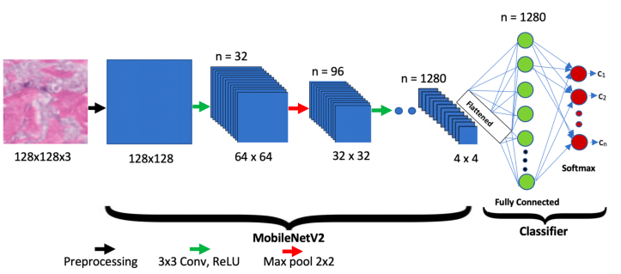
Proposed Solutions
Approach #2 – MobileNet CNN Model
Model: MobileNet (pretrained CNN model).
Tech Used: Tensorflow
Advantages:
Leveraging transfer learning to speed up training.
Fine-tuning a pretrained model for plant disease classification.
Objective: Compare performance to the custom CNN model.

Slide 6
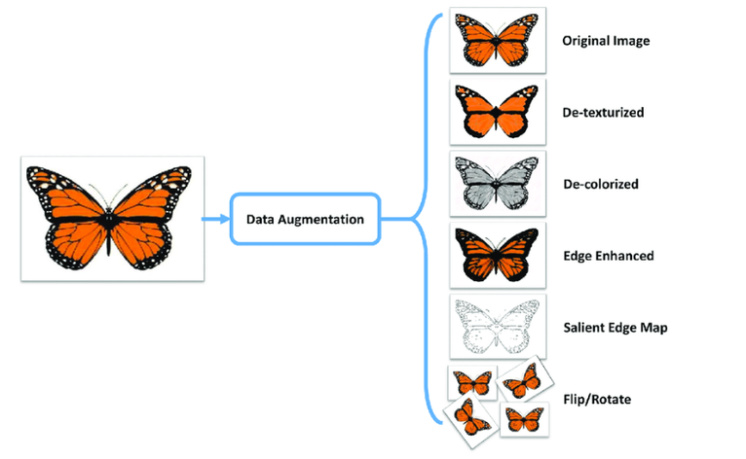
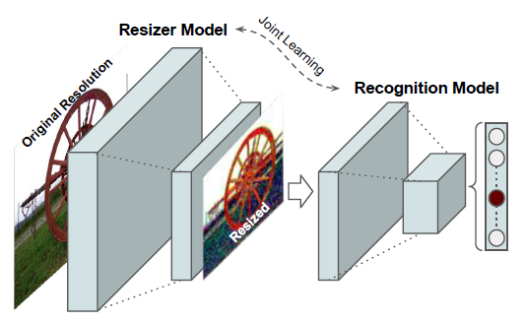
Data Preprocessing
Image Augmentation:
Rotation, zoom, and horizontal flipping for better generalization.
Rescaling pixel values to [0, 1] for neural network optimization.
Shear Transformation: To simulate changes in perspective.
Image Resizing: Resizing images to a fixed size (e.g., 150x150 pixels)

Slide 7
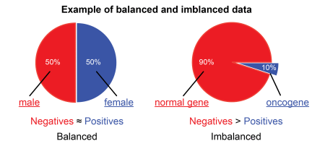
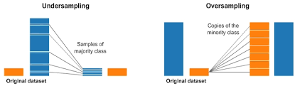
Data Preprocessing
Training-Validation Split: 80% for training, 20% for validation.
Handling Class Imbalance:
Issue: Some disease classes may have fewer images than others.
Using Undersampling and Oversampling to Counter Class Imbalance.
Data Loading: Uses flow_from_directory to load images, resize them, and batch them for training and validation.

Slide 8
Model Evaluation
Performance Analysis and Accuracy Comparison
85.61%
91.97%
0.2524
0.78
0.75
Training Accuracy
Validation Accuracy
Final Loss(Validation)
Precision
Recall
Approach #1 – Custom CNN

Slide 9
Model Evaluation
Performance Analysis and Accuracy Comparison
87.82%
93.64%
0.1527
0.88
0.85
Training Accuracy
Validation Accuracy
Final Loss(Validation)
Precision
Recall
Approach #2 – MobileNet CNN Model

Slide 10
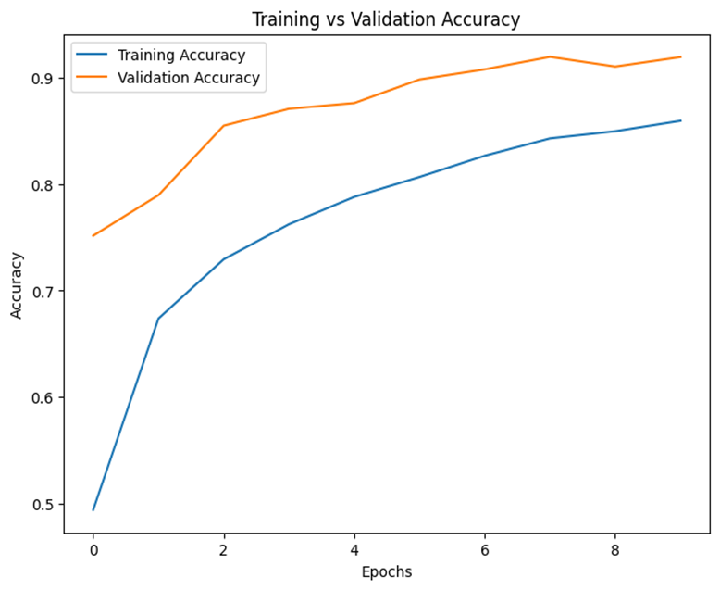
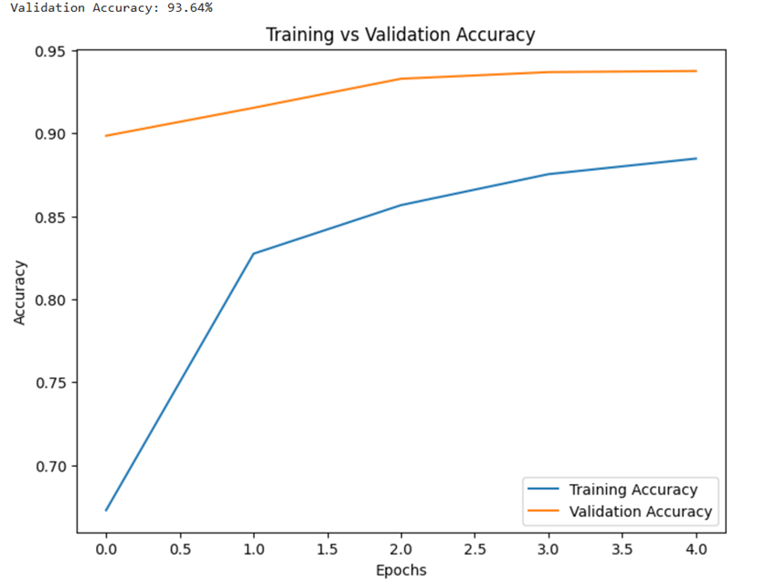
Model Comparison
Custom CNN Accuracy Graph
MobileNet CNN Accuracy Graph

Slide 11

Conclusion
The project incorporates two models: a custom CNN and a pretrained MobileNet, aiming for high accuracy in crop disease detection.
Data augmentation techniques like rotation, zoom, and flipping are implemented to improve model generalization and handle data variability.
MobileNet demonstrates higher accuracy and efficiency compared to the custom CNN, making it more suitable for real-time deployment.
The models address the challenge of classifying visually similar diseases, though further refinements are needed for edge cases.
The project highlights the potential of technology-driven solutions to improve agricultural productivity and reduce yield losses.
The approach lays a foundation for experimenting with ensemble methods or advanced architectures to enhance future performance.
The project emphasizes the importance of high-quality, diverse datasets for robust model performance across varied scenarios.
It integrates the trained models into a web application to provide scalable and accessible solutions for disease diagnosis.

Slide 12


Work Distribution
Shubham Tandon-E23CSEU1730
Training Custom CNN + PPT + Report
Vipin Yadav-E23CSEU1728
EDA + Training MobileNet CNN + Front End
Abhay Pratap-E23CSEU1720
Data Visualization + BackEnd + Deployment

